Slide 1
CS 230 Project (IntelLigent Prefetchers)
Data Prefetching for Graphs, SPEC, CPU, servers and SAT workloads
Josyula Venkata Aditya – 210050075
Ananth Krishna Kidambi – 210051002
Guramrit Singh - 210050061

Slide 2
The Project
Firstly, what are prefetchers?
A prefetcher is a mechanism designed to improve performance by predicting what data will be needed next and loading it into caches before it is actually requested by the processor.
The instruction pointer classifier based prefetching (IPCP) uses the fact that in different situations, different types of prefetching are optimal for different instruction pointers, thus selecting between constant stride prefetching, complex stride prefetching and stream prefetching.
The goal of this project was to improve upon this idea.

Slide 3
Observations
Firstly, we observed that TLB communication wasn't being used in the original implementation. So, we thought if using the TLB could lead to a possible optimization.
Secondly, it was observed that the number of page breaks that happen in the IPCP due to the prefetch physical address crossing the page boundary was large.
3.2 lakh/22 lakh prefetches in 482-sphinx trace and
12 lakh/ 40 lakh prefetches in 450-soplex trace are not issued due to overflowing page boundaries.
This lead us to our optimization : Page-Aware-Prefetching (PAP)

Slide 4
Page Aware Prefetching
For traces where there is less spatial locality in data access patterns, the prefetch addresses could potentially go out of pages.
We propose an optimization that breaks these boundaries :)
In essence, we fetch the physical page addresses whose virtual addresses the prefetcher is trying to prefetch.
We make requests to the TLB in order to get physical addresses and page allocations.

Slide 5
10K feet view of Implementation
Whenever a physical prefetch address goes out of the page, we record the virtual address corresponding to this address and store it in a pending_translations buffer.
Here we also store information such as the current cycle, number of pending prefetches, stride value etc.
We then issue a read request to DTLB for the virtual address, which would then return us the physical address corresponding to that virtual address after some cycles.
i.e. if (<phy_addr> + i) caused a page break, then we request the physical address of (<virt_addr> + i), where virt_addr corresponds to the virtual address of phy_addr.

Slide 6
Prefetcher
Out of Page prefetch
DTLB
TLB_REPLY
RQ
MSHR
Read Request to STLB
DTLB miss
STLB
Virtual page Address | Physical Page Address
RQ
MSHR
Get Page Mapping From Page Table
STLB Miss
Page Table

Slide 7
10K feet view of Implementation
Once we get the physical address, we first check the current cycle and compare it with the one stored on pending_translations buffer. If the difference is more than a threshold, we just drop this from the buffer.
Else, we issue prefetches with the received physical address as a base address and the stride value stored on the buffer against the virtual address.
If a page overflow happens for the second time, we don't issue read requests to the TLB, just to not overcrowd the TLB's read queue with prefetches

Slide 8
10K feet view of Implementation
This was done only for the L-1 data cache. For L-2, we retained the base implementation of the IPCP.
This essentially also allows the DTLB to learn page mappings, as we are prefetching the page mappings (that would be required in the future) into the DTLB(if they are not already available in the DTLB)
A lot of the implementation details have been hidden from the slides as the devil is in the details.

Slide 9
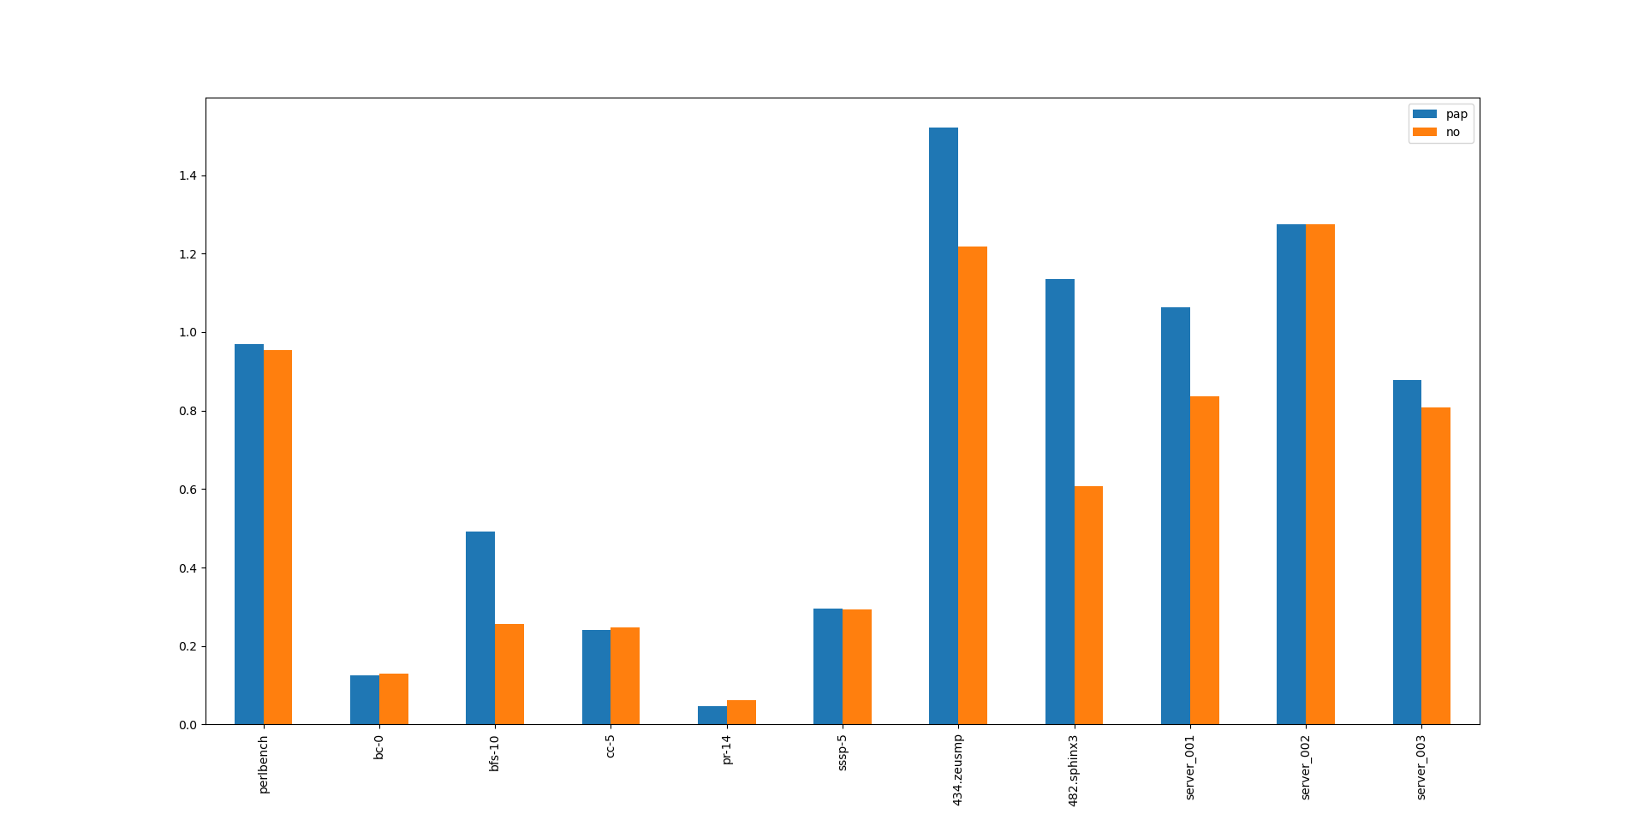
IPC Improvement Over No Prefetching

Slide 10
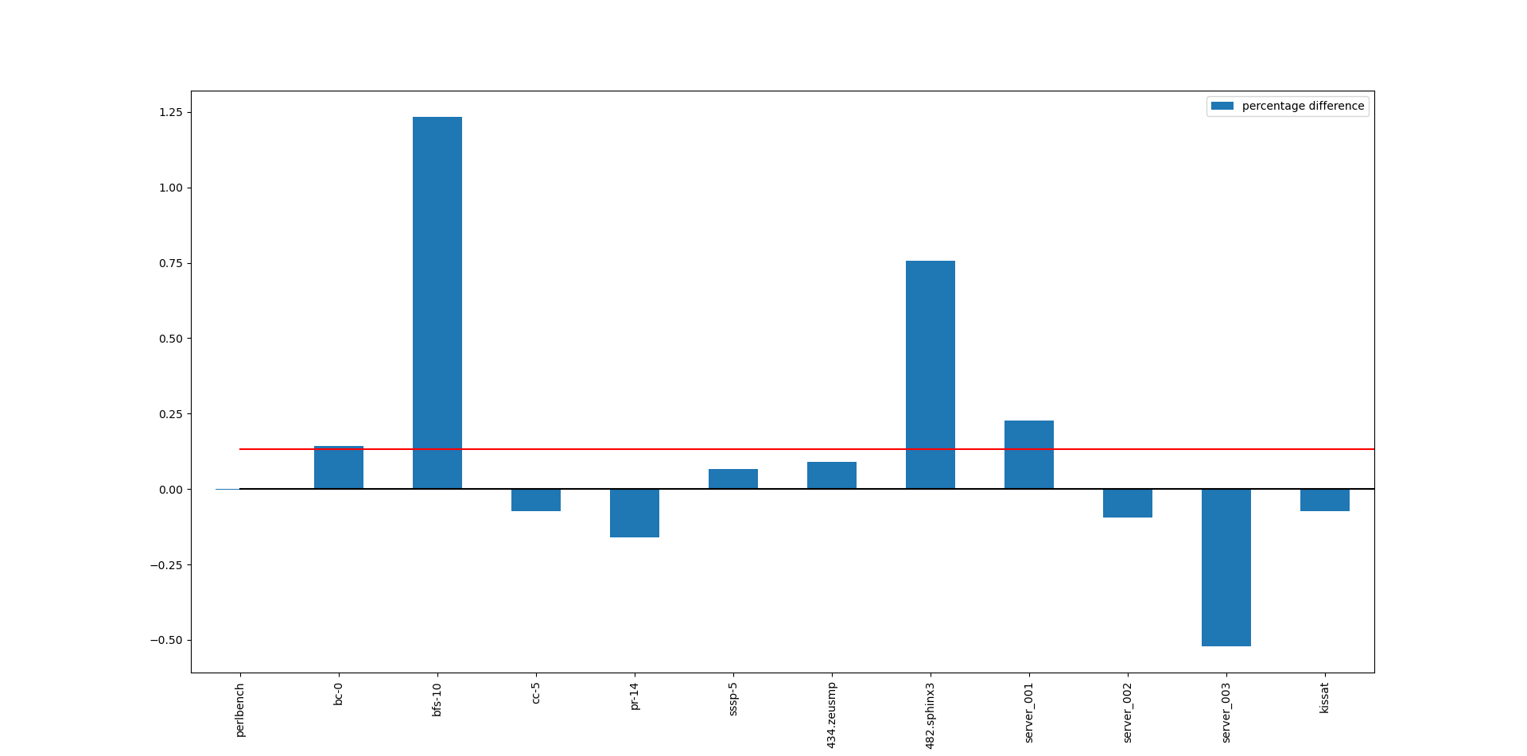
% Difference: IPCP vs PAP

Slide 11
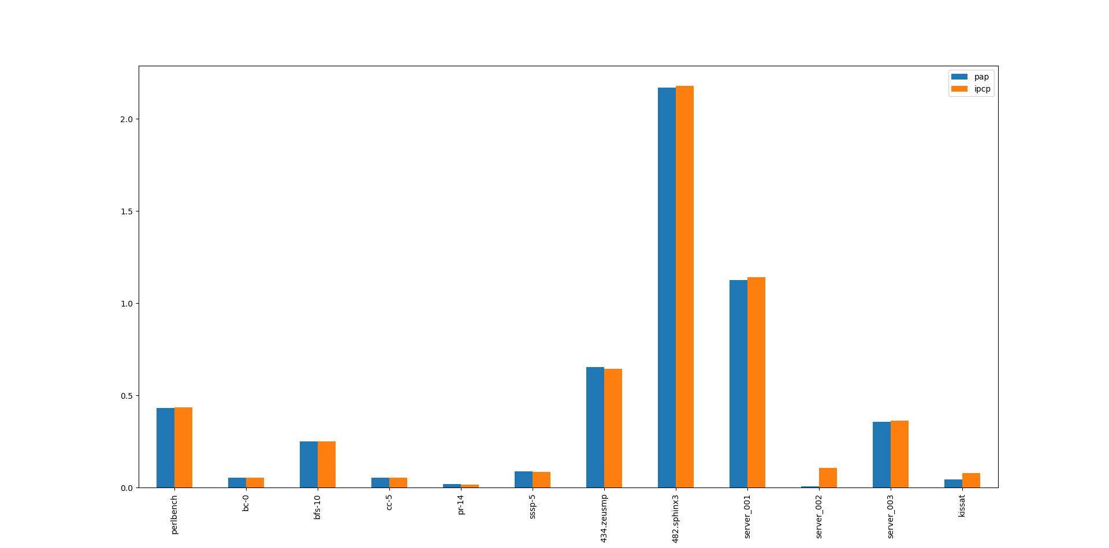
Useful / Useless Prefetch Ratios

Slide 12
Some numbers....
Geometric mean of the ratio of IPC of PAP to IPCP = 1.0013
Geometric mean of the ratio of IPC of PAP to no prefetching = 1.1476
Geometric mean of the ratio of IPC of PAP to IPCP on graph traces = 1.002645488496508

Slide 13
Conclusions
It has been generally observed that if there are many different page consecutive accesses in the program, then our optimization performs well.
An example of this is bfs, where not being able to pre-fetch from a different page may be a significant disadvantage.
Another possible optimization would be to use next line prefetching in the LLC, which reduces the number of misses in the LLC.

Slide 14
Conclusion
The expected jump in IPC is not obtained in some cases due to the following reasons-
When a prefetch spans more than one page, we fetch a new physical address only once and stop the prefetching if the prefetches span across more pages. This results in a decrease in IPC for some traces.
We also prevent merging of requests in the TLBs from the prefetcher with those from the instructions, and this results in an increase in the number of TLB accesses.
In case the memory accesses are random, then this results in an overhead due to the extra TLB accesses.
Note – We also didn't focus much on parameter tuning and focused more on ensuring the correctness of the code.

Slide 15
Thank You
This presentation is the culmination of an extremely intensive journey of 14 hours of continuous debugging and packet tracing in ChampSim. Hope you enjoyed this presentation ☺

